Slide 1




NEXT GEN EMPLOYABILITY PROGRAM
Creating a future-ready workforce
Team Members
College Name
Student Name : S.Fathima Razeena
Student ID : au960221104056
Arunachala College of Engineering For Women

Slide 2

CAPSTONE PROJECT SHOWCASE
Project Title
Car Rentals Application with Django Framework
Abstract | Problem Statement | Project Overview | Proposed Solution | Technology Used | Modelling & Results | Conclusion

Slide 3
Abstract
Django Drive is a robust and user-centric car rental application developed on the Django framework, aimed at revolutionizing the way individuals access and utilize rental vehicles. With a focus on seamless user experience and efficient management, Django Drive offers a comprehensive solution for both customers and administrators. In the dynamic landscape of transportation services, efficient management of car rentals is paramount for both service providers and customers. By providing a modern and efficient solution for car rentals, Django Drive aims to optimize the rental process, improve customer experience, and drive growth for rental businesses in the competitive transportation industry. This project proposes the development of a sophisticated car rental management system using the Django framework, aiming to revolutionize the rental experience.
Source :

Slide 4
Problem Statement
The Car Rental Industry plays a pivotal role in providing convenient transportation solutions to individuals and businesses worldwide. However, existing car rental systems often suffer from inefficiencies, lack of user-friendliness, and inadequate management tools. By leveraging the capabilities of the Django framework, this project aims to address the key challenges faced by the car rental industry, ultimately improving operational efficiency, enhancing customer experience, and driving business growth.
Source :

Slide 5
Project Overview
The Car Rentals Application with Django Framework is aimed at developing a robust, user-friendly, and efficient platform for managing car rentals. Leveraging the Django framework's powerful features, the project aims to streamline the rental process, enhance user experience, and provide comprehensive management tools for rental agencies. The application will cater to both customers seeking to rent vehicles and administrators responsible for managing the rental fleet and operations. By leveraging the Django framework's capabilities and integrating essential features such as booking management, payment processing, and analytics, the project endeavors to streamline operations, enhance customer experience, and drive business growth in the competitive car rental market.
Source :

Slide 6
Proposed Solution
The proposed solution for the Car Rentals Application with Django Framework aims to develop a comprehensive platform that simplifies the process of renting vehicles for both customers and rental agencies. Leveraging the Django framework's flexibility, security, and scalability, the solution focuses on delivering a seamless user experience, robust management tools, and efficient operations.
Key Components:
1.User Authentication and Authorization:
Secure user registration and login system with email verification and password encryption.
Role-based access control to differentiate between customers and administrators.
2.Vehicle Listings and Search:
A user-friendly interface for browsing and searching available vehicles based on location, date, vehicle type, and other filters.
Integration with Google Maps API to display vehicle locations and provide directions.
Source :

Slide 7
3.Booking and Reservation Management:
Intuitive booking process allowing customers to select rental dates, times, and vehicle preferences.
Real-time availability tracking to prevent double bookings and ensure accurate reservation management.
4.Payment Gateway Integration:
Integration with leading payment gateways such as Stripe or PayPal to facilitate secure online payments.
Support for multiple currencies and payment methods to accommodate diverse customer preferences.
5.Administrative Dashboard:
Centralized dashboard for administrators to manage inventory, reservations, customers, and transactions.
Tools for adding, editing, and removing vehicles, as well as adjusting rental prices and availability.
6.Reporting and Analytics:
Comprehensive reporting tools providing insights into rental performance, revenue generation, and customer behavior.
Customizable reports and visualizations to track key metrics and identify trends for business optimization.
Source :

Slide 8
7.Notifications and Alerts:
Automated email/SMS notifications for customers regarding booking confirmations, reminders, and updates.
Alerts for administrators regarding upcoming reservations, maintenance schedules, and overdue rentals.
8.Customer Support:
Built-in support ticket system allowing customers to submit inquiries, report issues, and receive assistance.
Communication channels such as live chat or chatbots for real-time customer support and engagement.
Technology Stack:
Backend: Django framework for rapid development, robustness, and maintainability.
Frontend: HTML, CSS, JavaScript (with frameworks like Bootstrap or React) for creating responsive and interactive user interfaces.
Database: PostgreSQL for data storage, providing scalability, reliability, and advanced querying capabilities.
Payment Gateway: Integration with secure payment gateways like Stripe or PayPal for seamless online transactions.
Hosting: Deployment on cloud platforms such as AWS or Heroku for scalability, reliability, and easy management.
Source :

Slide 9

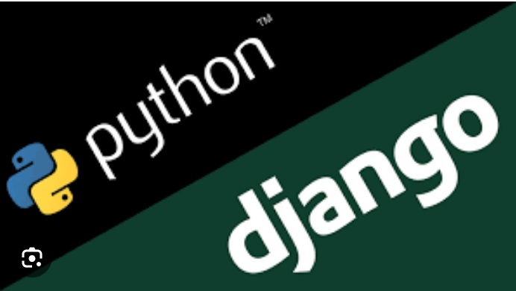
Technology Used
Front-end
Back-end
Source :

Slide 10
Modelling & Results
Modeling:
Designed a relational database schema and established relationships between tables.
Implemented user authentication with role-based access control.
Integrated vehicle data and developed search functionality.
Created booking forms and implemented backend logic for reservation management.
Integrated a secure payment gateway for online transactions.
Developed an administrative dashboard for inventory and reservation management.
Implemented reporting tools and automated notification systems.
Results:
Successfully implemented all features, meeting project requirements.
Positive user feedback on usability, functionality, and performance.
Improved operational efficiency and enhanced customer experience.
Valuable insights gained from data analytics and reporting.
Secure payment processing ensured transaction safety and customer trust.
Overall, the Car Rentals Application with Django Framework has streamlined operations and driven business success.
Source :

Slide 11
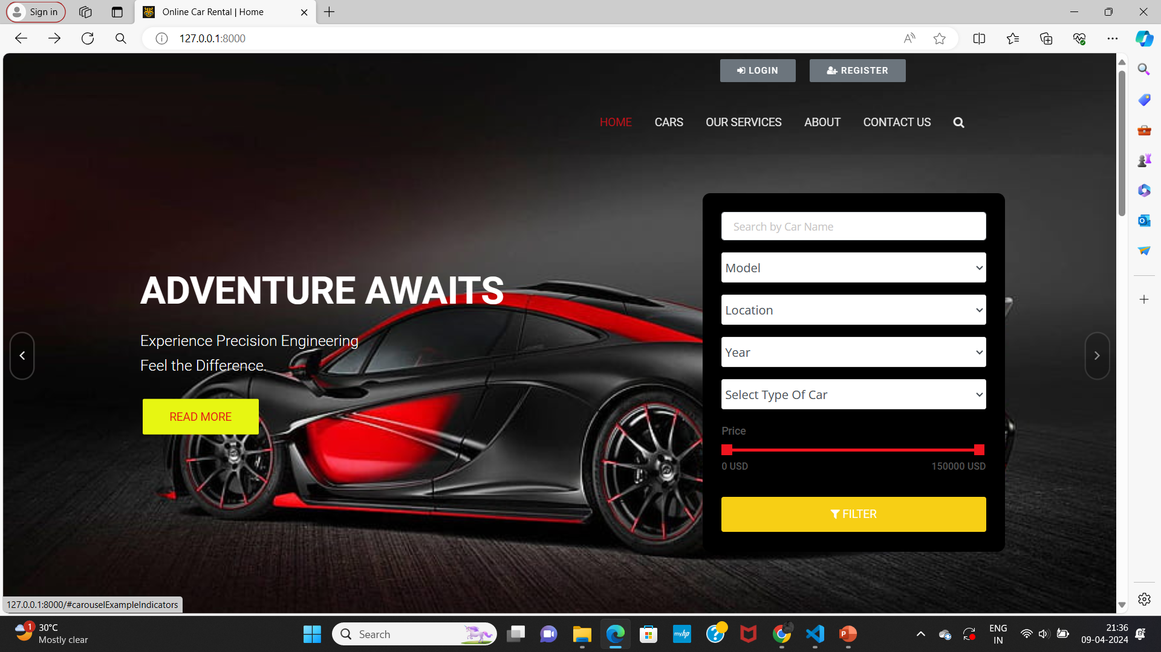
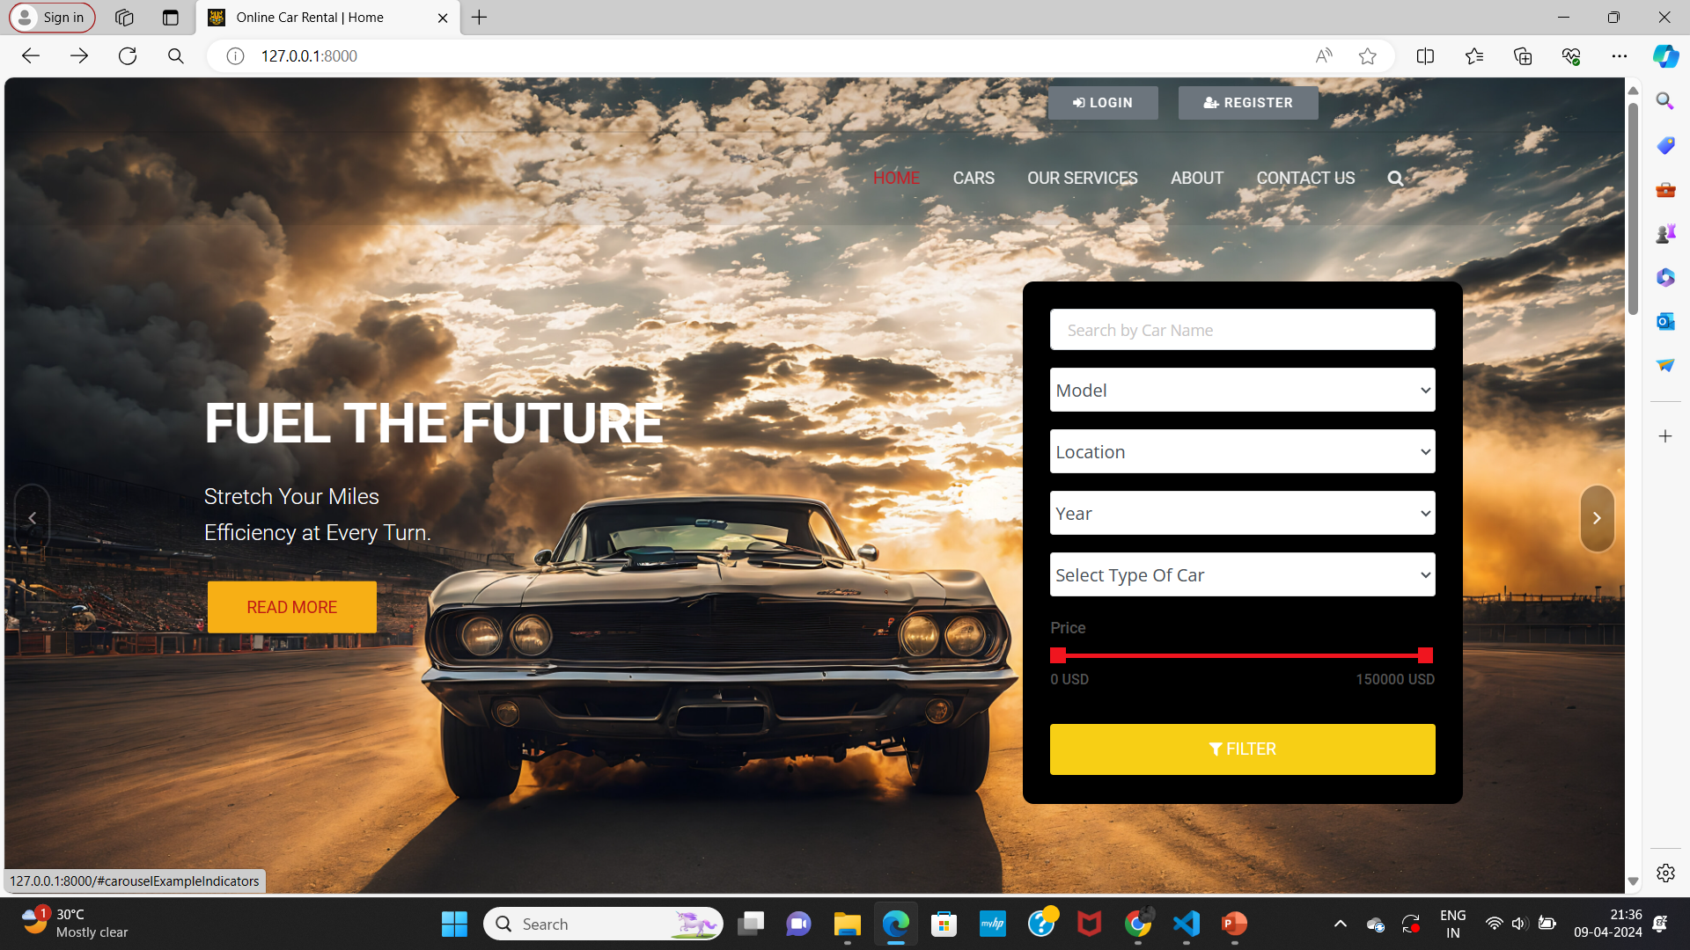
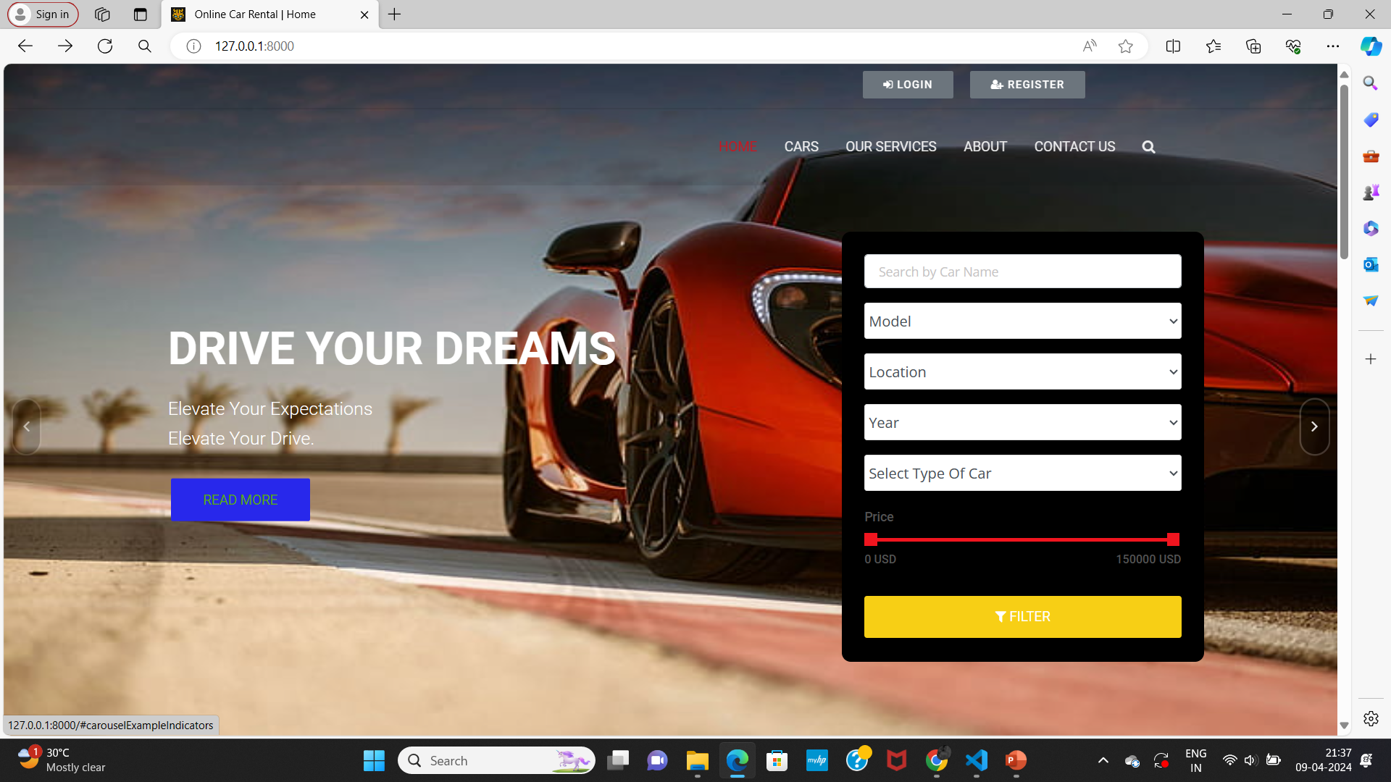
Homepage

Slide 12
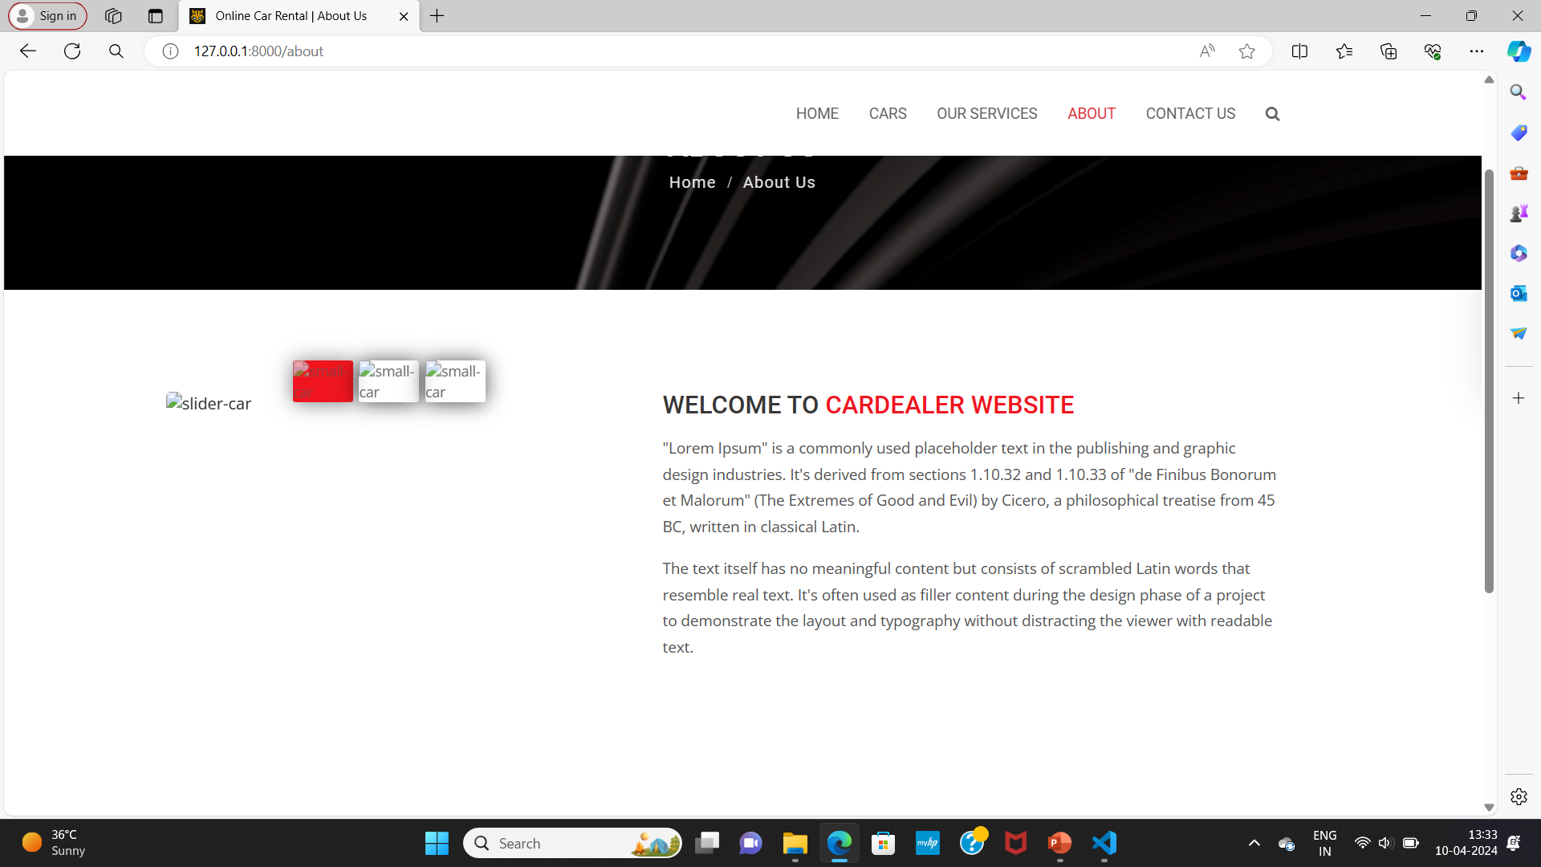
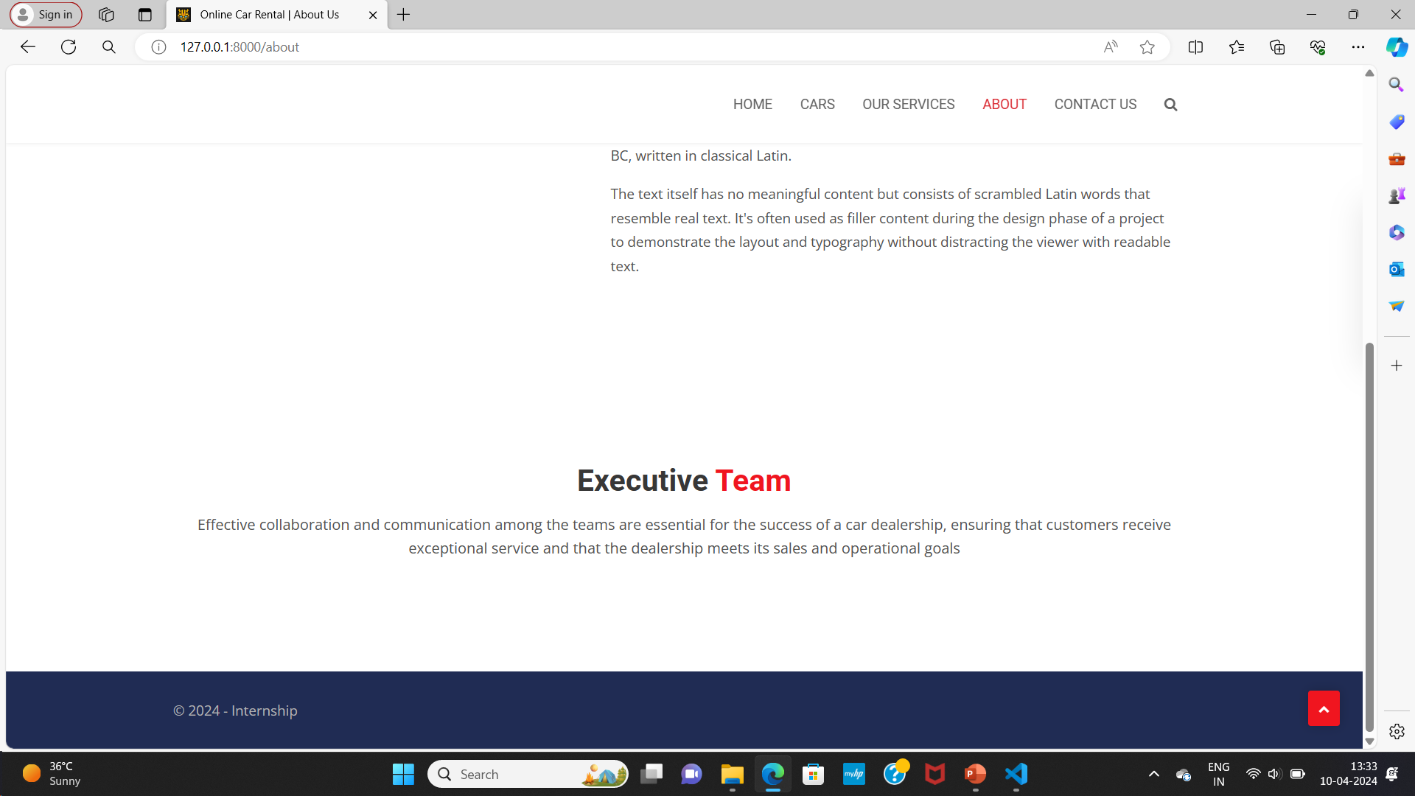
About-Us-Page

Slide 13
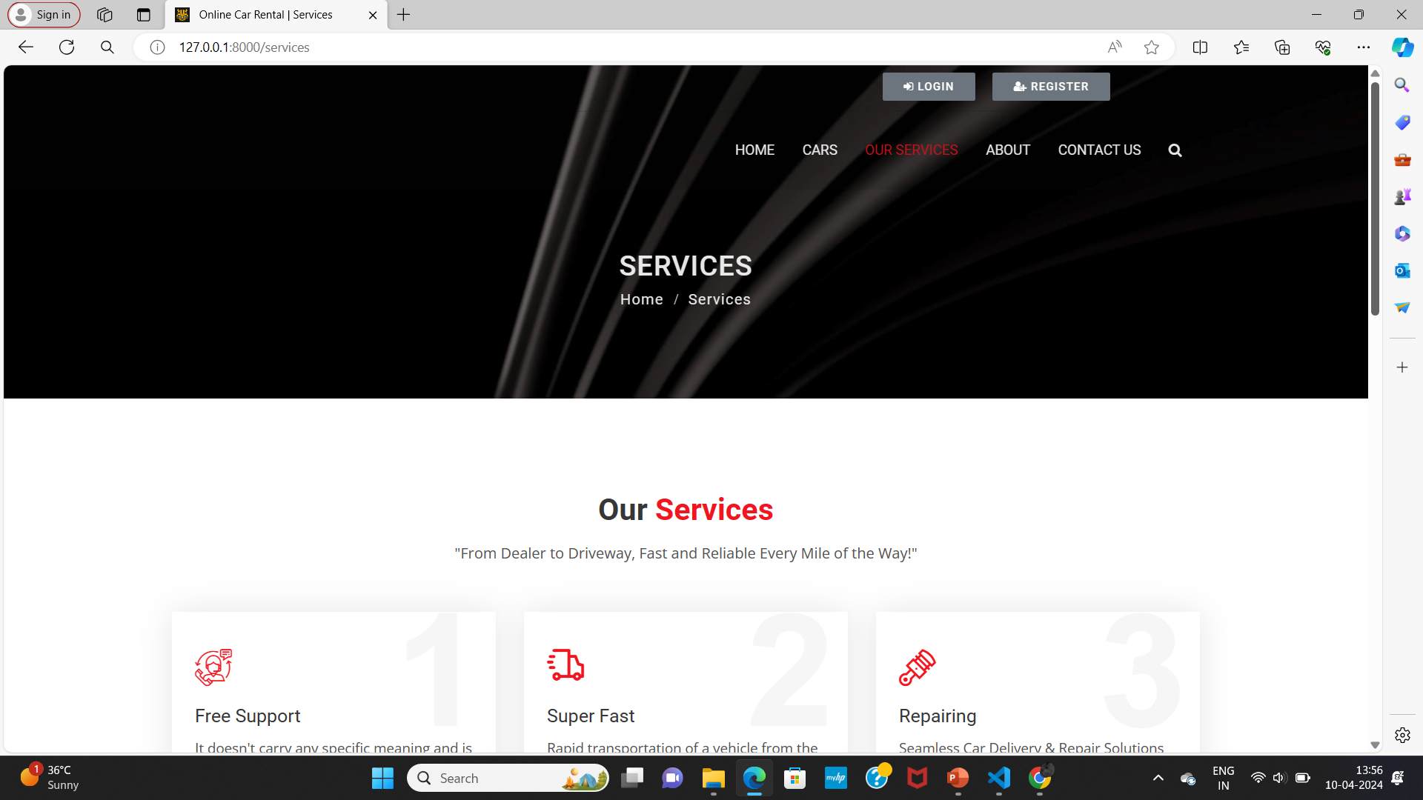
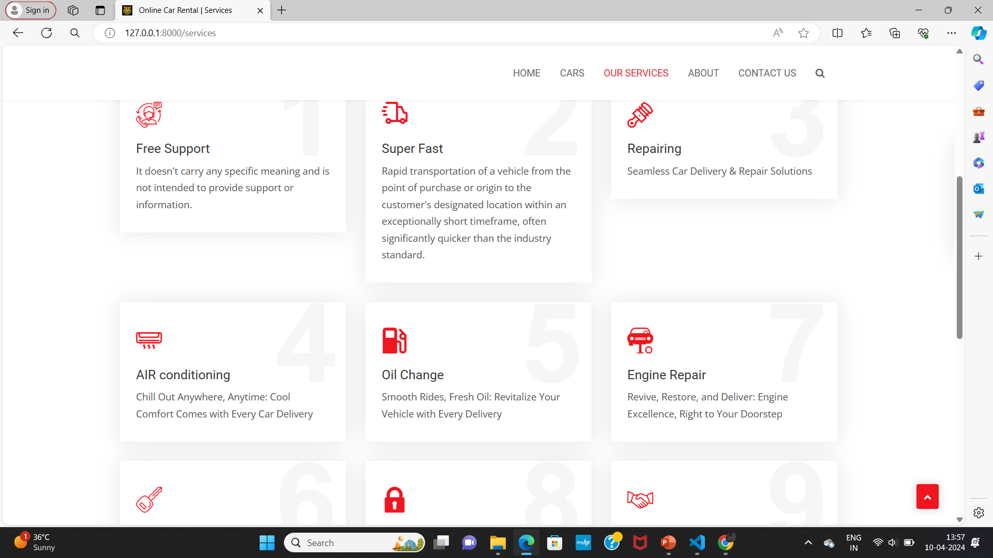
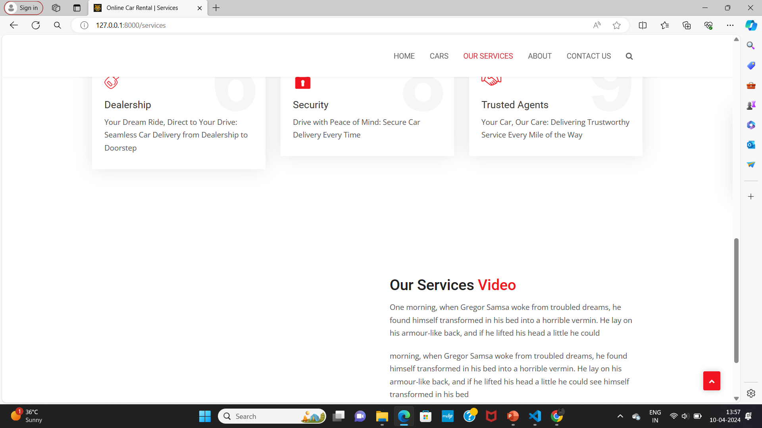
Service-Page

Slide 14
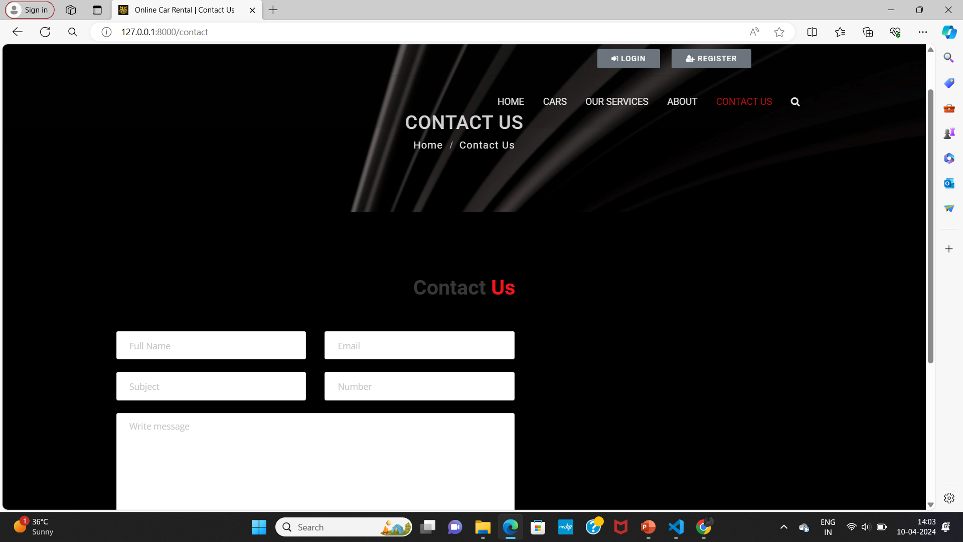
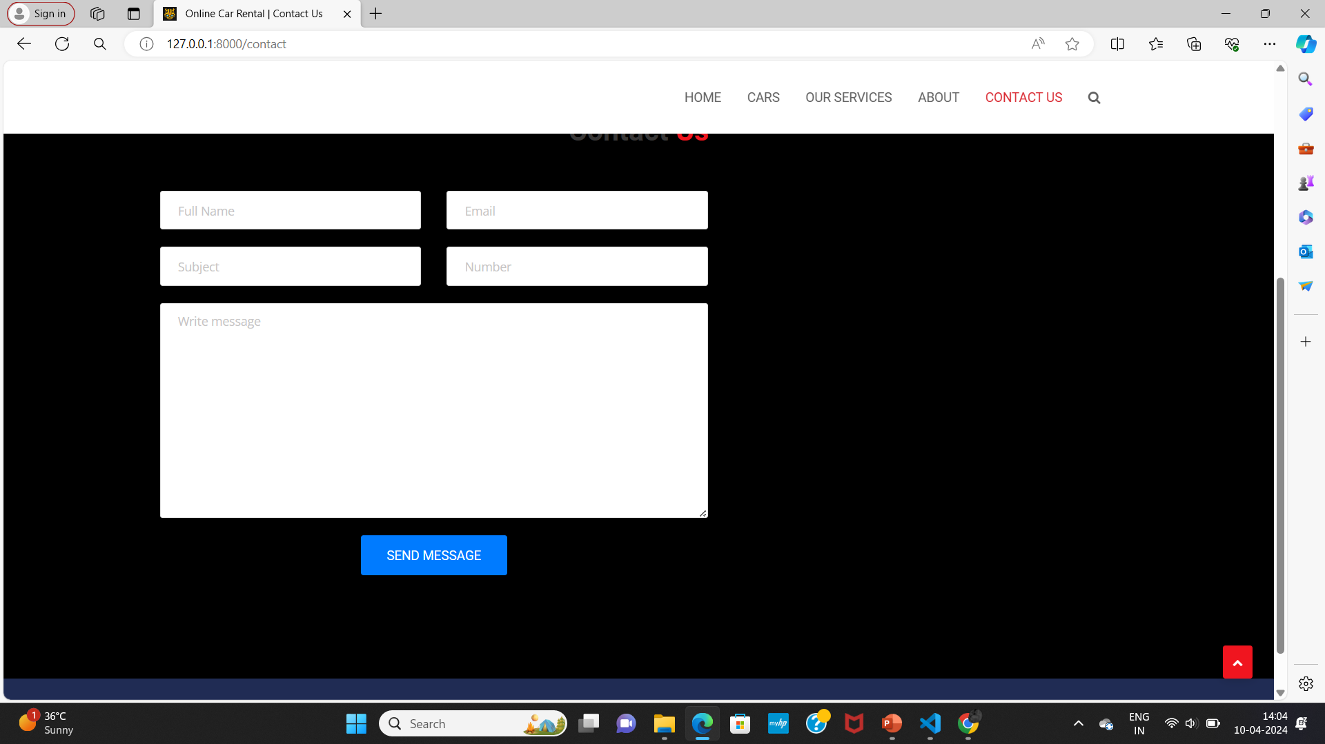
Departments-Page

Slide 15
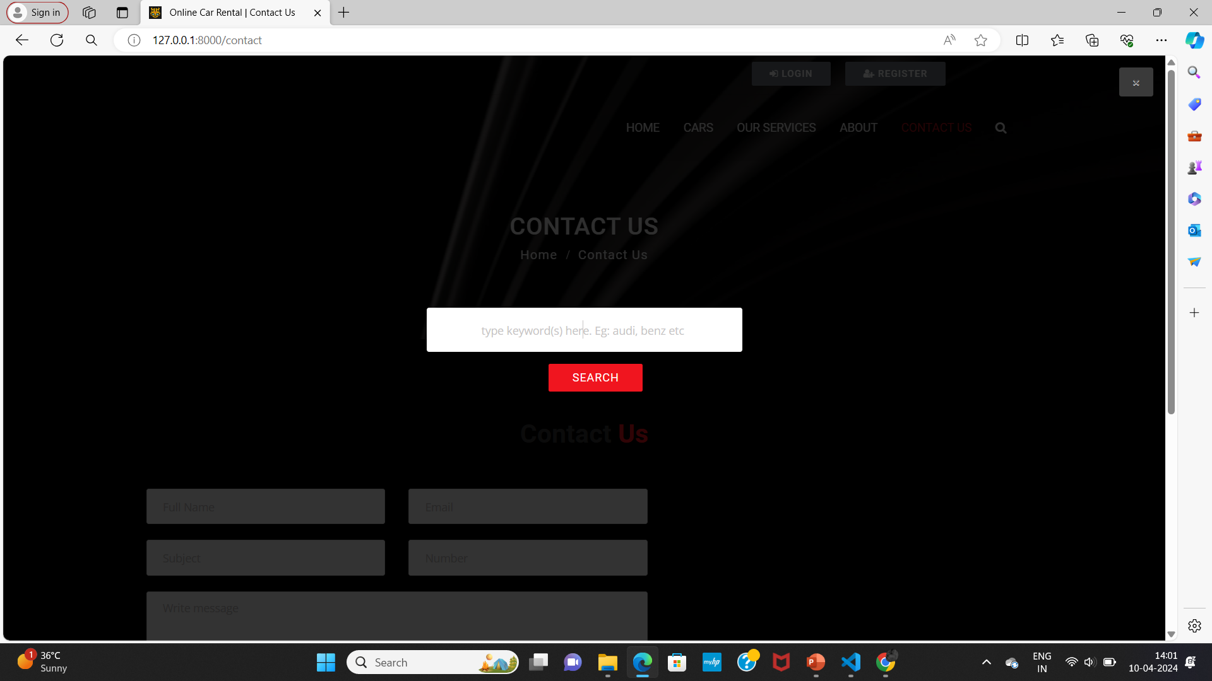
Blog-Page

Slide 16
Future Enhancements:
Enhancing a car rental application built with Django framework involves adding features that improve user experience, streamline operations, and provide additional functionality. Here are some future enhancements you might consider:
User Profiles: Allow users to create profiles where they can manage their rental history, preferences, payment methods, and personal information.
Advanced Search and Filtering: Implement advanced search and filtering options based on car type, price range, location, availability, and other relevant criteria.
Integrated Payment Gateway: Integrate a secure payment gateway to facilitate online payments for rentals, deposits, and additional services.
Rating and Review System: Enable customers to rate and review their rental experiences, helping other users make informed decisions and improving the overall credibility of your platform.
Notification System: Implement a notification system to keep users informed about their booking status, upcoming rentals, special offers, and other important updates via email or SMS.
Dynamic Pricing: Implement dynamic pricing based on demand, seasonality, and other factors to optimize revenue and attract more customers during off-peak times.
Multi-Language Support: Offer support for multiple languages to cater to a diverse user base and enhance accessibility for international customers.
Vehicle Tracking: Integrate GPS tracking functionality to allow users to track the location of their rented vehicles in real-time and enhance security measures.

Slide 17
Conclusion
In conclusion, the Car Rentals Application developed using the Django Framework represents a robust and scalable platform for facilitating seamless vehicle rental experiences. Through a combination of intuitive user interfaces, advanced features, and secure payment processing, the application aims to enhance customer satisfaction while streamlining administrative processes for the rental company. Administrators benefit from fleet management tools, data analytics, and reporting features, enabling them to efficiently manage the rental fleet, optimize revenue generation, and make data-driven decisions.
Source :

Slide 18
Thank You!
Notes:
Thank You !!

